Slide 1
Wells Fargo Campus Analytics Challenge
By Avi Miller, James Rundle, and Bradley Odac
Objective:
Our idea for the Wells Fargo Campus Analytics Challenge is to gamify the app by using trends we found in the data to predict future spending habits. Wells Fargo would offer personalized “challenges”encouraging Wells Fargo credit card users to get out and spend more money on their card, in categories we can predict they will be more likely to spend in. Completions of these challennges would result in a reward if they spend enough in the given category. Goals would be given a set time to complete, causing the customer to spend before they lose the opportunity. Our overall objective is to use our correlation and predictive methods to create a better customer experience.

Slide 2
Using the Data
Our particular concept relies totally on data gathered just from regular use of a Wells Fargo credit card. The concept can be expanded to debit card use. The customer is not directly interacting with Wells Fargo but the predictive modeling will be affected the more a customer uses the card, and thusly the “challenges” will be ever changing and always align to the customer's current spending habits. Referencing data obtained from customers associated bank accounts can be used to provide more personally tailored challenges to the customers.
Examples of challenges:
You’ve been a homebody and visited *particular retail store* a lot lately! Mix things up by visiting Target 3 times next week and get an extra 3% cash back on your next retail purchase.
*Customer who has been consistently making relatively large deposits into savings and shows a history of electronic purchases*
You’ve been a champ on your savings game lately! Treat yoself! Here is an extra 5% cash back on a purchase over $500 at BestBuy.

Slide 3
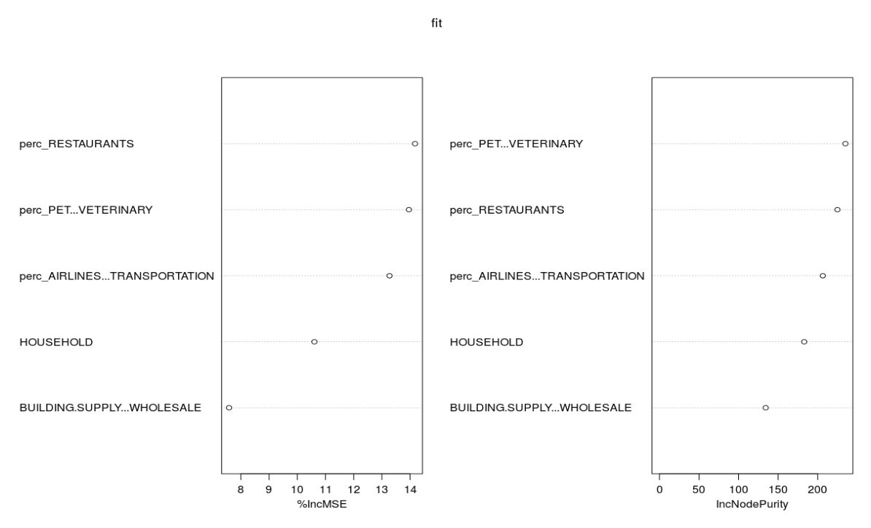
Retail Correlations:
These Results show how we are able to predict how much a person will spend on retail, based on several categories of their past spendings.

Slide 4
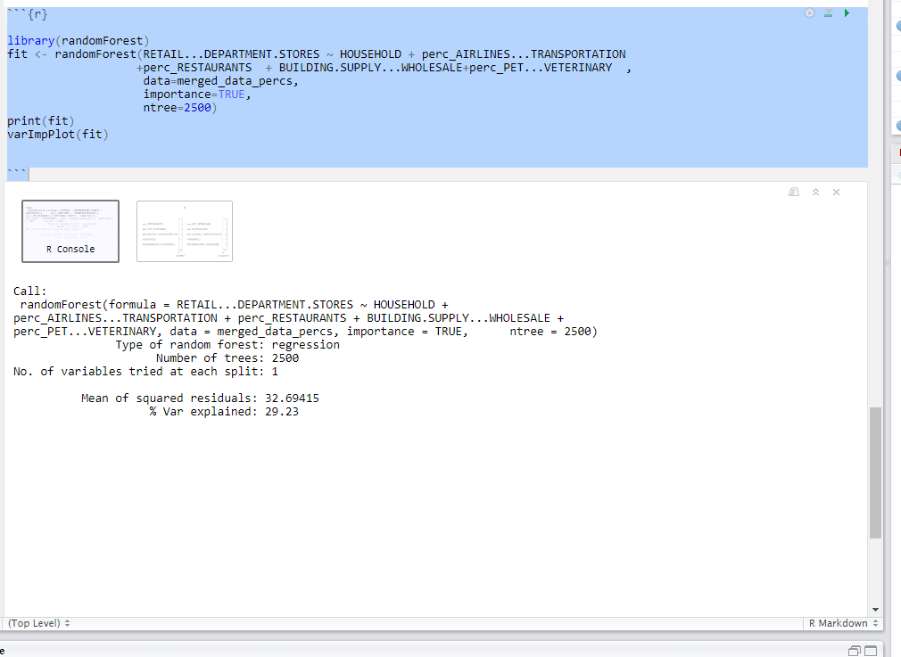
We used the correlation plots for guidance on choosing our prediction factors, but alot of trial and error is involved.
The randomForest regression uses factors from the merged_data_percs dataframe and tries to predict the number of purchases a customer will make in the catagory “Retail and Department Stores”
Here it shown that the data we found can accurately predict retail spending about 30% of the time

Slide 5
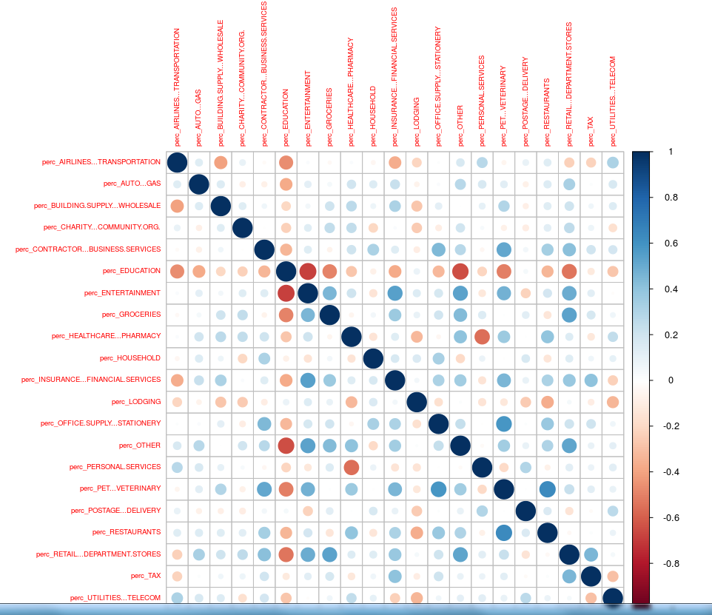
This chart shows how the different categories are correlated to each other based on the percentage of money customers spent in each category.
One things that stands out is how much education is negatively correlated to almost every category. This is likely due to the expensiveness of college education and how it leaves less spending money for other categories such as entertainment.

Slide 6
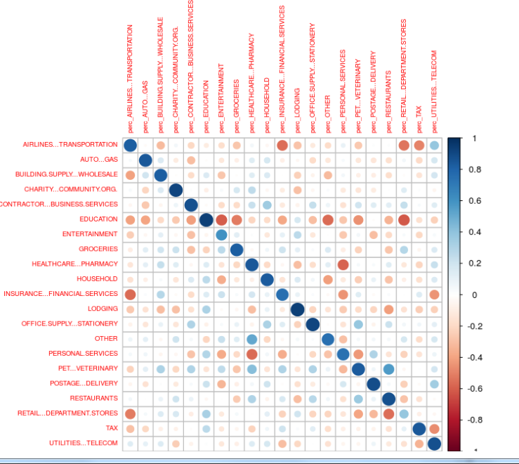
Like the last slide, this chart shows correlations between spending categories. This Chart is different because on this one the values on the left are based on number of transactions and the top is base on the percent of money spent in each category. More negative correlations were found showing that customers often must choose to make purchases in whatever category is most important to them.

Slide 7
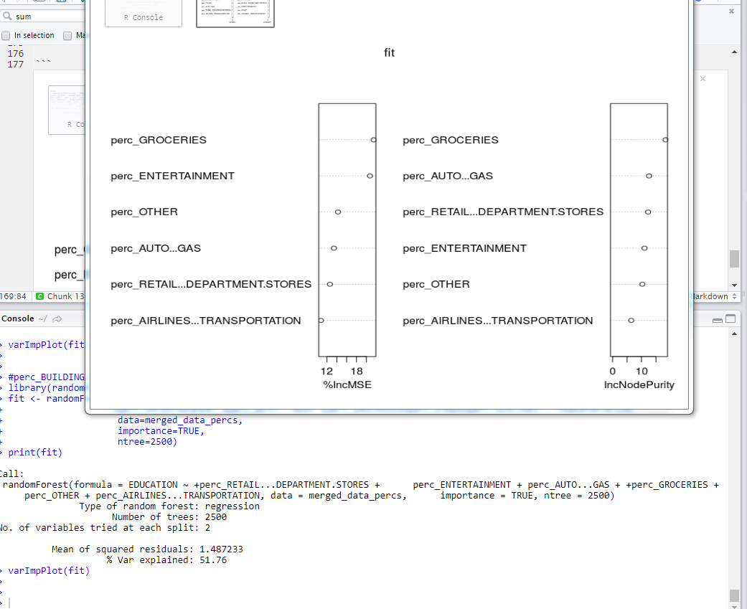
The effect of Education:
Because we found there was so much correlation between education and the other categories, we ran the same tests that we did for retail but for education.
Here it shown that with the data we used we can accurately predict the amount of education transactions about 52% of the time.

Slide 8
In Conclusion:
In conclusion we would use the data found to create goals for the customer. If we are able to predict that there is a significant chance the customer will make a retail purchase, we would give them a chance to receive a reward if they spent x amount of dollars on retail by the end of that week. The rewards could range from wells fargo points to 1% extra cashback on retail purchases for a month.
The gamification model has been proven to work and increase spending with the Starbucks App. According to an article written by Luke Dormehl on the Fast Company website, 16% of all starbucks transactions are used with the starbucks app, because the customers appreciate rewards for their spendings. These rewards cause the customers to go back to starbucks more, and spend more money there. Using this model, Wells Fargo app users would have a more positive customer experience, while also increasing spendings made on their Wells Fargo credit card.

